Slide 1
THE COLLECTIVE COMPLAINTS PROCEDURE UNDER THE EUROPEAN SOCIAL CHARTER
AMSTERDAM, 10 NOVEMBER 2014

Slide 2
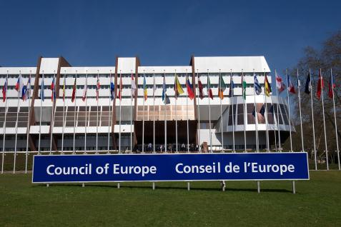



Slide 3
THE EUROPEAN SOCIAL CHARTER
A human rights treaty which guarantees and promotes social rights in Europe; a counterpart to the European Convention on Human Rights
31 articles covering areas such as:
Employment
Social protection
Housing
Health
Education
Movement of persons
Non-discrimination

Slide 4


THE EUROPEAN COMMITTEE OF SOCIAL RIGHTS

Slide 5
Additional Protocol providing for a system of collective complaints
Adopted on 9 November 1995
Entry into force on 1 July 1998
Aim: improving the enforcement of the rights guaranteed by the Charter
Optional (currently accepted by 15 States)

Slide 6
STATES HAVING ACCEPTED COMPLAINTS
15 states Belgium Bulgaria Croatia Cyprus Czech Republic Finland France Greece Ireland Italy Norway Netherlands Portugal Slovenia Sweden
 | 43 States Parties to the Charter
 | 47 CoE Member States

Slide 7
WHO MAY LODGE A COMPLAINT ?
EUROPEAN TRADE UNIONS/EMPLOYERS
INGOs
NATIONAL TRADE UNIONS/EMPLOYERS
[NATIONAL NGOs]

Slide 8
111 registered complaints
France : 31
Greece : 16
Portugal : 11
Belgium : 8
Italy : 8
Finland : 8
Ireland : 8
Bulgaria : 6
Netherlands : 3
Sweden : 3
Croatia : 2
Slovenia : 2
Norway : 2
Czech Republic: 2
Cyprus : 1

Slide 9
Complaints about…
child labour,
working time,
the right to organise, including in the military and in the police,
forced labour,
labour health and safety,
discrimination in various contexts,
union security clauses,
the right to strike,
educational provision for autistic children,
sex education in schools,
housing rights, including the right to shelter of irregular migrants,
corporal punishment of children,
austerity measures,
the level of social security benefits,
social services for the elderly,
the situation of Roma,
etc…

Slide 10
Admissibility
  PROCEDURE
  Not compulsory to consult the respondent Government (Rule 29§4)
  Possibility of written submissions
  New practice: single decision on admissibility and merits (Rule 29§2)
  CRITERIA/CONDITIONS
  Few formal criteria
  No exhaustion of domestic remedies, no victim status
  Parallel pending procedures not an obstacle

Slide 11
Merits
Written procedure (Rule 31)
Public hearing (Rule 33)
Third party intervention
  Rule 32
  Rule 32A
Immediate measures (Rule 36)

Slide 12
FOLLOW-UP
FOLLOW-UP = CHANGES AT NATIONAL LEVEL TO REMEDY VIOLATIONS OF THE CHARTER
Changes to legislation/caselaw/practice

Slide 13
Role of the Committee of Ministers I
“Article 9
1 On the basis of the report of the Committee of Independent Experts, the Committee of Ministers shall adopt a resolution by a majority of those voting. If the Committee of Independent Experts finds that the Charter has not been applied in a satisfactory manner, the Committee of Ministers shall adopt, by a majority of two-thirds of those voting, a recommendation addressed to the Contracting Party concerned. […]”

Slide 14
Role of the Committee of Ministers II
“The Committee of Ministers cannot reverse the legal assessment made by the Committee of Independent Experts. However, its decision (resolution or recommendation) may be based on social and economic policy considerations.”
(Explanatory Report, para. 46, emphasis added).

Slide 15
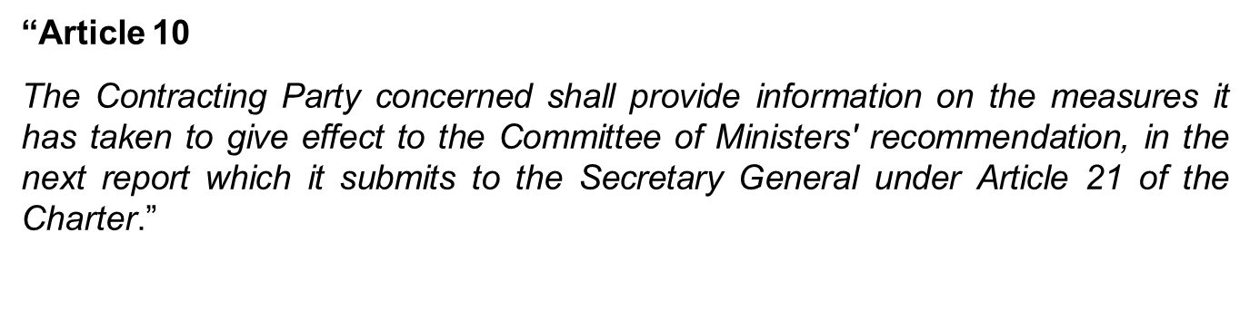
Link to the reporting procedure

Slide 16
Flow of the follow-up process
Notification of the decision to the parties and transmission to the Committee of Ministers: 1-3 weeks after adoption
CEC v. the Netherlands: 9 July 2014 (public on 10 November 2014)
Resolution by the Committee of Ministers: 3-6 months after adoption
CEC v. the Netherlands: underway (early 2015?)
Next report under the reporting procedure: within 1-2 years
Next Dutch report on follow-up: 31 October 2015

Slide 17
Example of CM Resolution
DCI v. the Netherlands, Complaint No. 47/2008 (operative part)
“1. Takes note of the statement made by the respondent government and of the information it has communicated and welcomes the authorities’ commitment to ensure the effective implementation of the rights of children unlawfully present in its jurisdiction (see appendix to this resolution);
2. Recognises the limitation of the scope of the European Social Charter (revised) in terms of persons protected, laid down in paragraph 1 of the Appendix to the Charter, but notes that this does not relieve states from their responsibility to prevent homelessness of persons unlawfully present in their jurisdiction, more particularly when minors are involved;
3. Looks forward to the Netherlands reporting that, at the time of the submission of the next report concerning the relevant provisions of the European Social Charter, the situation is in full conformity with the European Social Charter.”

Slide 18
MORE INFORMATION
www.coe.int/socialcharter
  Hudoc database
  Factsheets by country
  Infos on changes and improvements at national level

